Slide 1
GESTURE RECOGNITION PROJECT
Submitted by –
Srikanth SP and Anjali Vashisth

Slide 2
CONTENT
Problem Statement
Objective
Generator
Models used
Tabulated Result – write Up

Slide 3
Problem Statement
Imagine you are working as a data scientist at a home electronics company which manufactures state of the art smart televisions. You want to develop a cool feature in the smart-TV that can recognize five different gestures performed by the user which will help users control the TV without using a remote. The gestures are continuously monitored by the webcam mounted on the TV. Each gesture corresponds to a specific command:
Action | For
Thumbs up | Increase in volume
Thumbs down | Decrease in volume
Left swipe | Jump back 10 secs
Right swipe | Jump forward 10 secs
Stop | Pause the movie

Slide 4
Objective
We read all of the images in the folder, crop them, then resize them as we iterate over the number of batches. There are two distinct image shapes that are recognized. When upgrading a picture, batch data and batch labels are returned after the convo3D issue has been fixed.

Slide 5
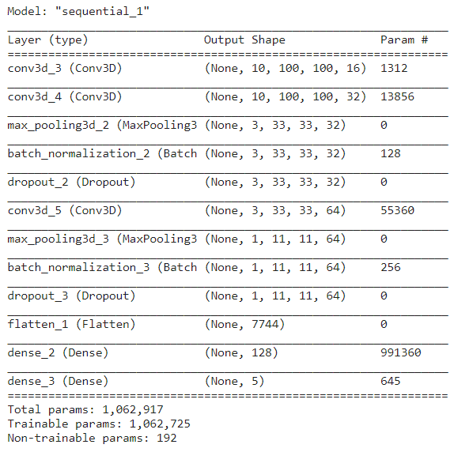
Model 1
EXPERIMENT NO. | MODEL USED | RESULT
1 | Conv3D | 18% - 23%
No. of Epochs – 5
Batch size – 47
Activation function used – ‘elu’ because it helps in converging cost to zero faster.
With an accuracy of 18% to 23% - we get a poor result
Next Plan – Increase Sample size and reduce complexity

Slide 6
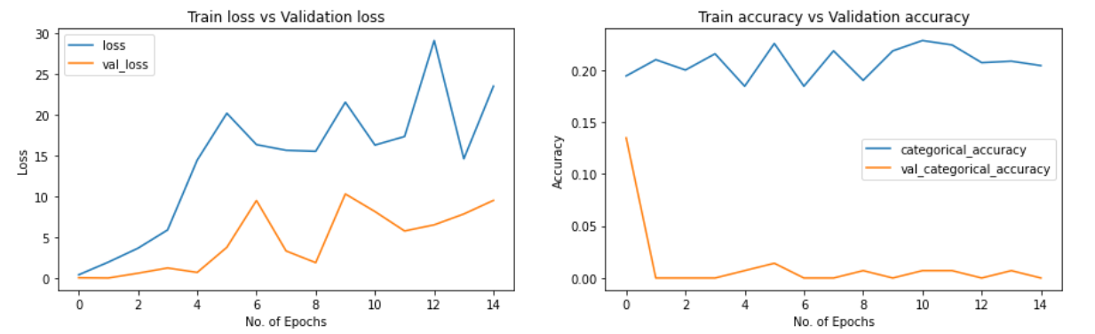
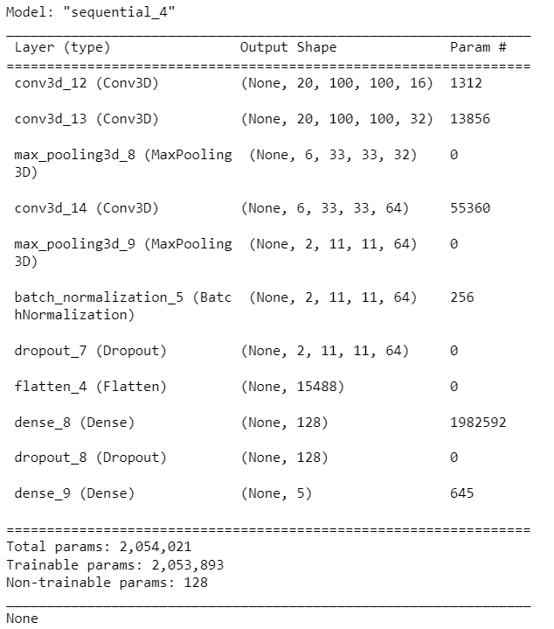
Model 2
EXPERIMENT NO. | MODEL USED | RESULT
2 | Conv3D | 22% accuracy
No. of Epochs – 15
Batch size – 47
Activation function used – ‘elu’ because it helps in converging cost to zero faster.
Dropped a Function from 3rd layer – batch Normalization
Max. Training Accuracy 0.22836878895759583
Max. Validaiton Accuracy 0.13475176692008972 ☺
Next Plan – Change in activation function; and removal of a layer

Slide 7
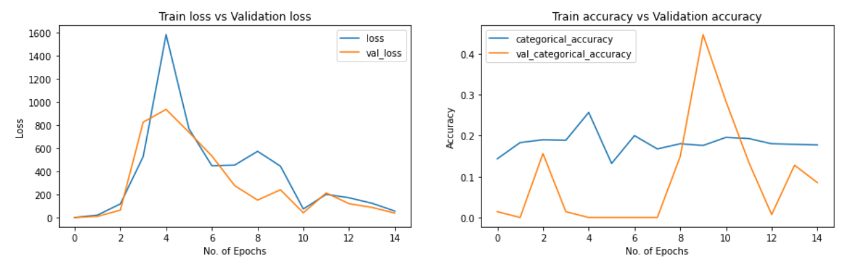
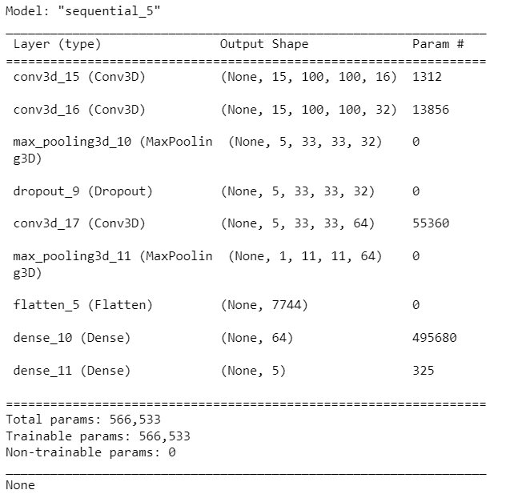
Model 3
EXPERIMENT NO. | MODEL USED | RESULT
3 | Conv3D | 25% accuracy
No. of Epochs – 15
Batch size – 47
Activation function used – ‘Relu’ because it helps in pushing mean activation to zero with lower computational complexity. Dropped a Function from 3rd layer – dropout layer removed
Max. Training Accuracy 0.2567375898361206
Max. Validaiton Accuracy 0.44680851697921753 ☺
Next Plan – Change in kernel size

Slide 8
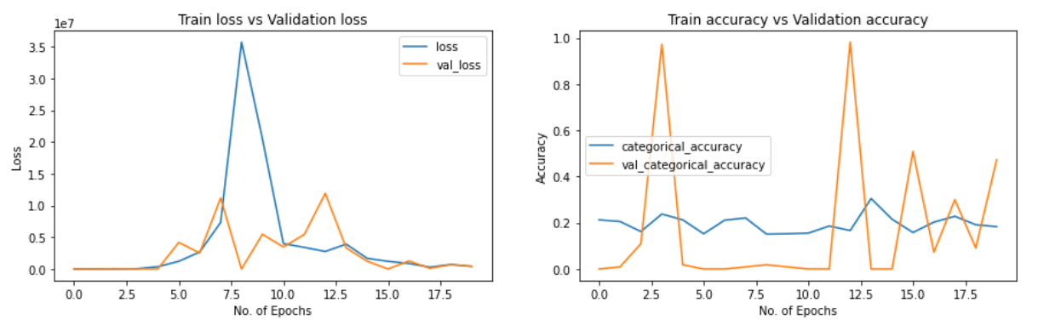
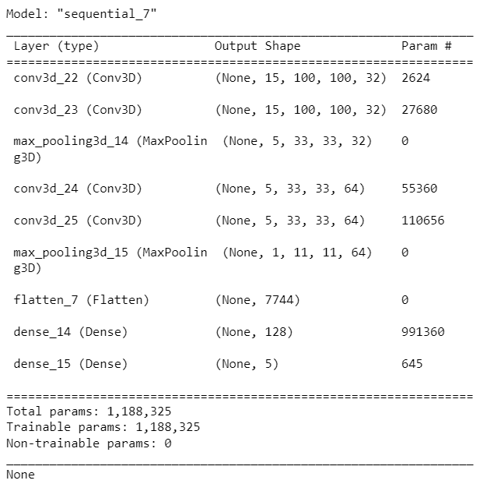
Model 4
EXPERIMENT NO. | MODEL USED | RESULT
4 | Conv3D | 31% accuracy
No. of Epochs – 20
Batch size – 55
Activation function used – ‘Relu’ because it helps in pushing mean activation to zero with lower computational complexity.
Max. Training Accuracy 0.3048951029777527
Max. Validaiton Accuracy 0.9818181991577148☺
Accuracy is slightly improved but there is huge difference to validation accuracy
- Accuracy is improved after removing dropouts but training accuracy has not increased a lot.
- validation accuracy is sky rocketing comparatively. this could be because of data.
- training it for more time might increase the training accuracy

Slide 9
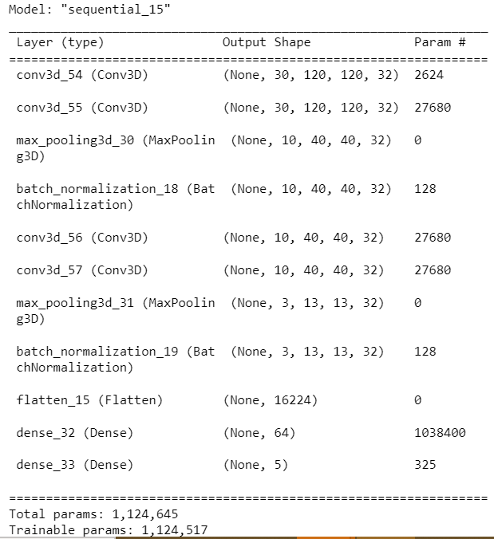
Model 5
EXPERIMENT NO. | MODEL USED | RESULT
5 | Conv3D | Had to stop because of a lot of time taken
No. of Epochs – 33
Batch size – 65
Activation function used – ‘Relu’ because it helps in pushing mean activation to zero with lower computational complexity.
Because it took several hours to run, we had to unfortunatenly stop in middle where in the max accuracy it got was 27 % accuracy
Next plan – use convo2d+LSTM

Slide 10
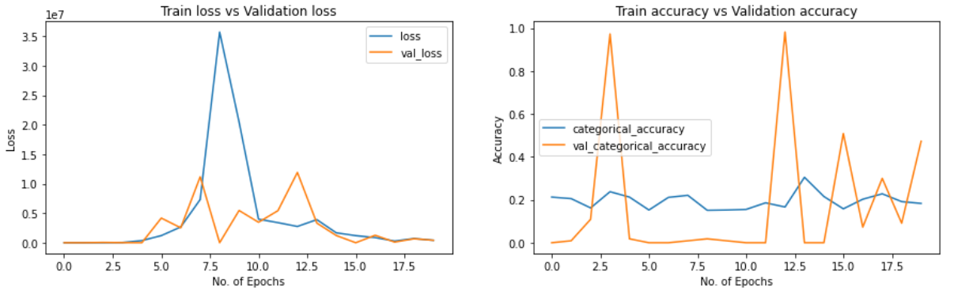
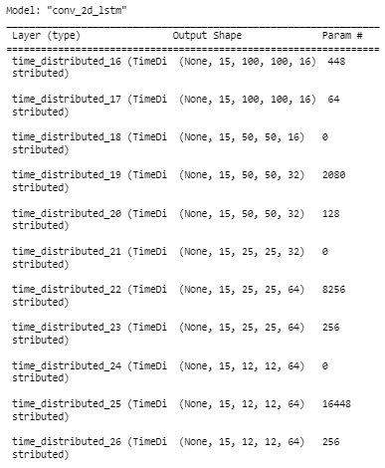
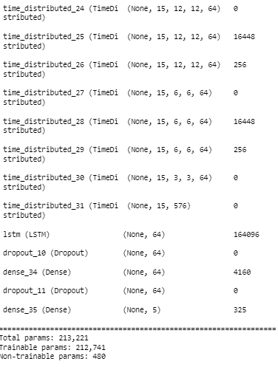
Model 6
EXPERIMENT NO. | MODEL USED | RESULT
6 | Conv2D+LSTM | 31% accuracy
No. of Epochs – 10
Batch size – 55
Activation function used – ‘Relu’ because it helps in pushing mean activation to zero with lower computational complexity.
Convo2D + LSTM using Timedistributed function 100x100 cropping of image
Max. Training Accuracy 0.3048951029777527
Max. Validaiton Accuracy 0.9818181991577148
We realised it has similar result as Model 4

Slide 11
Summarizing
Similar results of Model 6 & Model 4
- Model 6 - Conv2d & LSTM
-- TimeDistributed Conv2d, BatchNormalization, Dropout
-- num_epochs = 10, batch_size = 55, Img size 15 X 100 x 100
-- Max. Training Accuracy 0.3048951029777527
-- Max. Validaiton Accuracy 0.9818181991577148
- Model 4 – Conv3D
-- num_epochs = 20, batch_size = 55, Img size 15 X 100 x 100
-- Max. Training Accuracy 0.3048951029777527
-- Max. Validaiton Accuracy 0.9818181991577148

Slide 12
Write Up Table
EXPERIMENT | MODEL | RESULT | EXPLANATION
1 | Conv3D | 18% - 23% | Need to Increase Sample size and reduce complexity
2 | Conv3D | 22% accuracy | Need to change the activation function and complexity
3 | Conv3D | 25% accuracy | Need to change kernel size, epochs and batch size
4 | Conv3D | 31% accuracy | Need to add more epochs and batch size
5 | Conv3D | Stopped | Had to stop because of a lot of time taken – need to use diff model
Final Model | Conv2D+LSTM | 31% accuracy | num_epochs = 20, batch_size = 55, Img size 15 X 100 x 100

Slide 13
THANK YOU ☺

